Slide 1

ANALYTICS AVENUE
TALENTENA EVENT 2024

Slide 2

ANALYTICS AVENUE – AN INTRO
Analytics Avenue is a dedicated educational platform specializing in mentoring students, career-transitioning individuals, and the unemployed in SQL, Power BI, Python, Data Science, and Machine Learning.
Boasting mentors with a minimum of 5+ years' experience, the platform focuses on hands-on learning through real-time projects.
It aims to equip learners with practical expertise and prepare them for success in the data-driven industries by offering personalized guidance and structured learning pathways.

Slide 3

ABOUT MYSELF
I’m Abinaya Palanisamy, a final-year Computer Science student from Arignar Anna Government Arts College in Trichy, deeply passionate about data analysis.
Currently interning at Analytics Avenue, I’m diving into the world of Data Analysis through hands-on learning and real-time projects. Engaging in NSS activities and winning competitions highlights my dedication and eagerness to excel.
Driven by an insatiable thirst for knowledge, I'm committed to continuous learning and growth. With a fervent enthusiasm for data analysis, I’m poised to make my mark in the dynamic world of data science.
Click here to view my resume

Slide 4

YOUTUBE USER ENGAGEMENT AND PREFERENCE ANALYSIS – PROBLEM STATEMENT
Understanding YouTube user preferences and engagement is challenging due to the platform's vast content diversity and dynamic features. Creators and marketers lack a comprehensive analysis tool that can effectively capture and interpret user behaviors. Existing analytics fall short in providing actionable insights, leaving a critical gap in optimizing content strategy. A need exists for a robust YouTube analysis tool that integrates diverse data sources, adapts to platform changes, and offers actionable recommendations to enhance content creation and user engagement strategies.

Slide 5

YOUTUBE USER PREFERENCES and engagement analysis
Deciphering YouTube user preferences and engagement patterns presents a multifaceted challenge.
Understanding diverse content interests, interpreting engagement metrics effectively, fostering audience growth, and navigating dynamic platform algorithms require sophisticated analytics.
Developing robust analytical frameworks is essential to optimize content strategies, refine targeting, and enhance user experiences on the platform.
Click to view Dataset

Slide 6
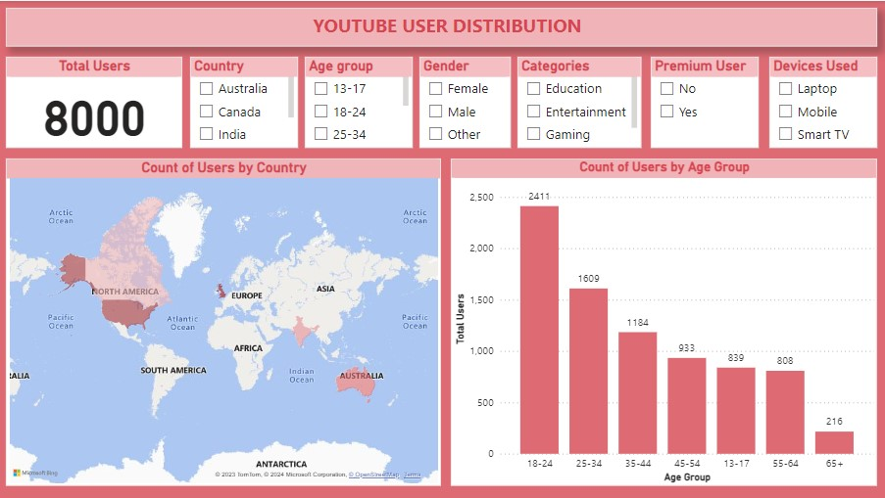

Slide 7
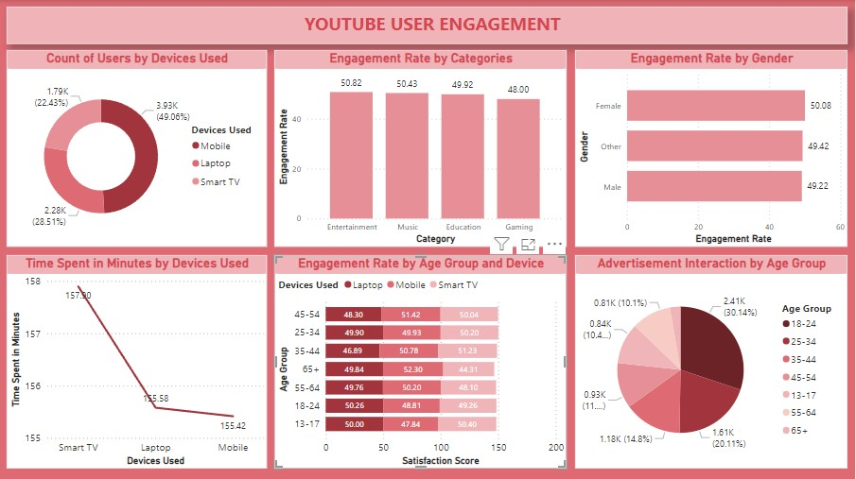

Slide 8
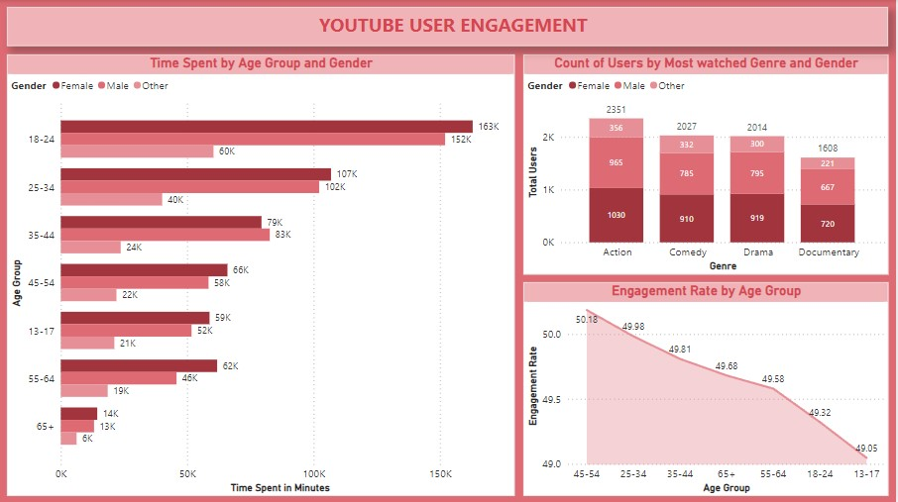

Slide 9
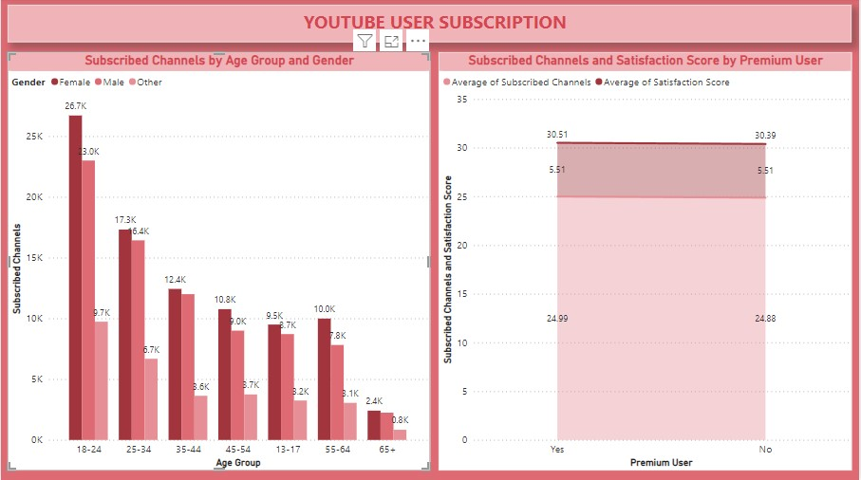

Slide 10
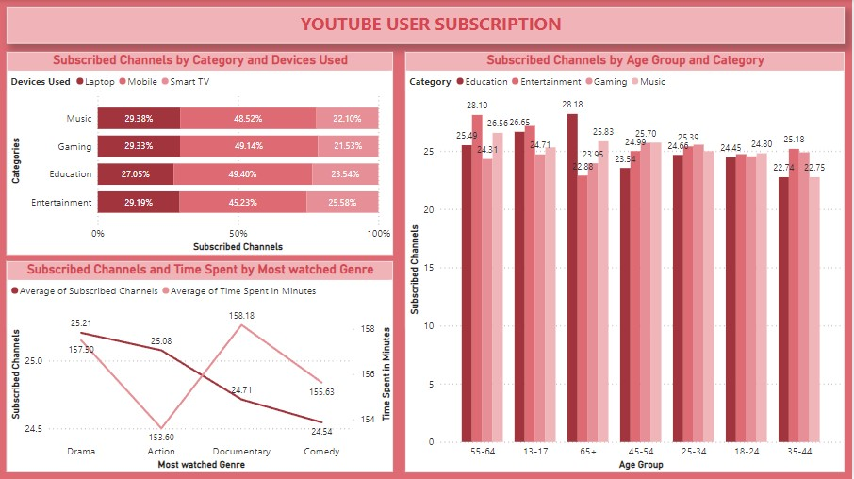

Slide 11
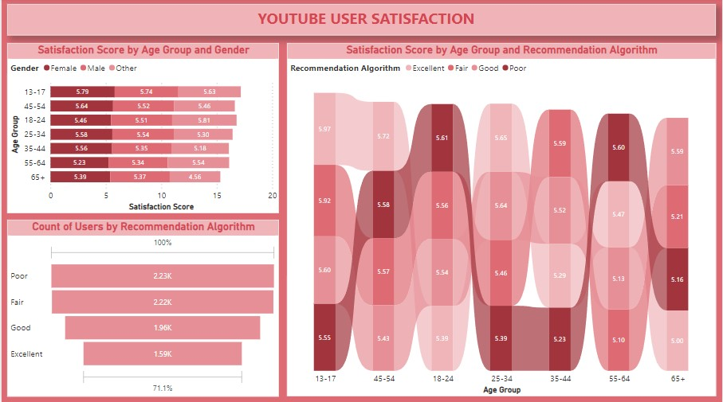

Slide 12
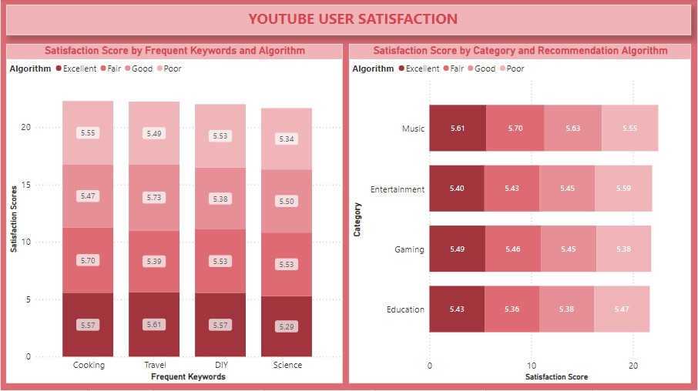

Slide 13
KEY INSIGHTS
Highest number of YouTube users belong to the age group 18-24.
Canada has the greatest number of users in this data.
Users use mobiles mostly for watching YouTube videos.
Entertainment has the most engagement rate followed by music.
Users belong to the age group 18-24 engage with YouTube more and interact with advertisements more than other age group.
Females spent their time on YouTube than other genders.
Action Genre of videos are most watched followed by Comedy.
Users belong to the age group 13-17 has the most satisfied experience with YouTube followed by the age group 45-54.
Users who belong to the age group 55 and above feels that their recommendation algorithm is poor.
Music has the highest satisfaction score and recommendation algorithm.

Slide 14

USE cases
Social Media Platforms: Analyzing user interactions and content preferences on platforms like Facebook, Instagram, Twitter, and TikTok aids in refining marketing strategies and enhancing user engagement.
Streaming Services: Understanding user preferences on platforms such as Netflix or Spotify helps personalize content recommendations, improving user satisfaction.
E-commerce Platforms: Analyzing user behaviors and purchase patterns on platforms like Amazon optimizes product recommendations and marketing strategies.
Gaming Industry: Analyzing player behaviors within gaming platforms enables personalized gaming experiences and targeted in-game offers.
News and Media Outlets: Understanding reader/viewer preferences assists in tailoring content delivery and curating news for specific audiences.
Educational Platforms: Analyzing learner behaviors and preferences helps personalize course recommendations, improving the learning experience.
.

Slide 15

Thank you

